Slide 1
UNIT 1 – LESSON C
1C OPEN YOUR BOOKS, PLEASE

Slide 2


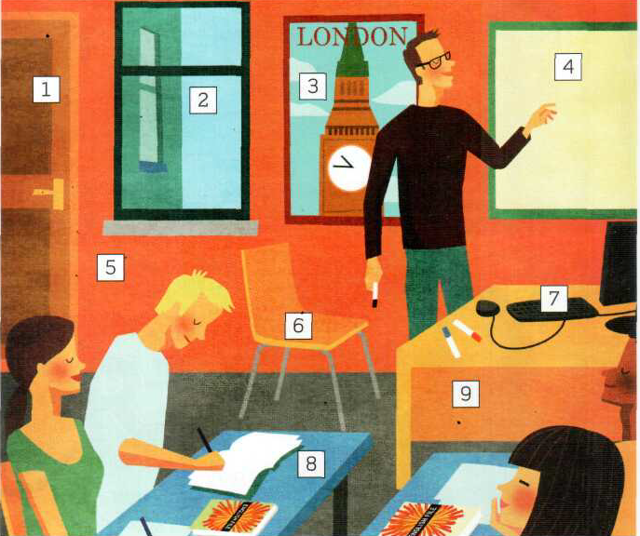
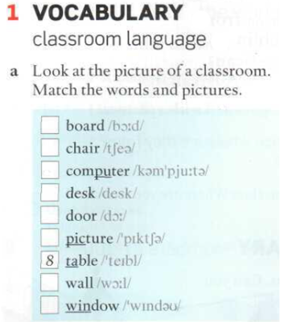
Point at the objects and say the words.
4
6
7
9
1
3
5
2

Slide 3
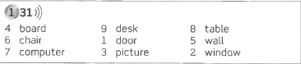

Slide 4
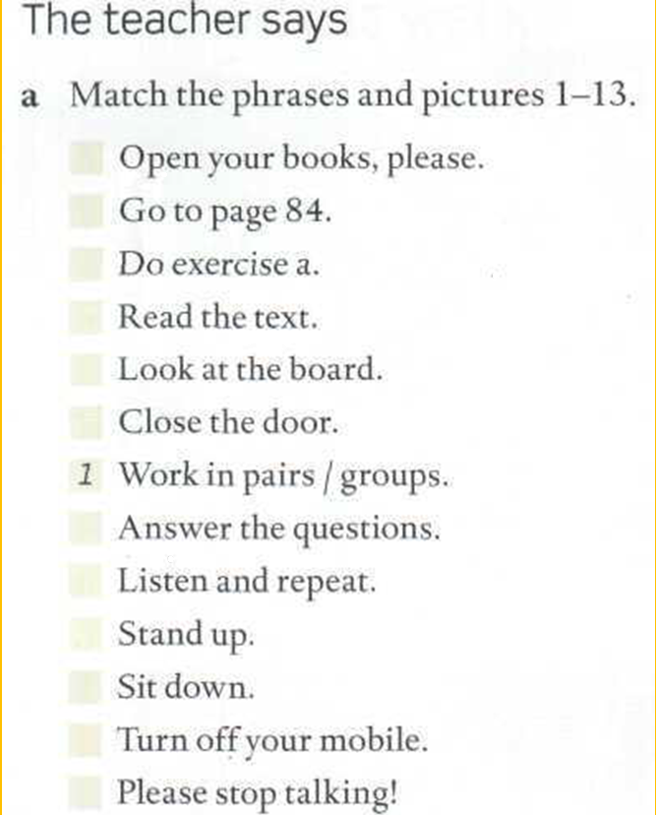
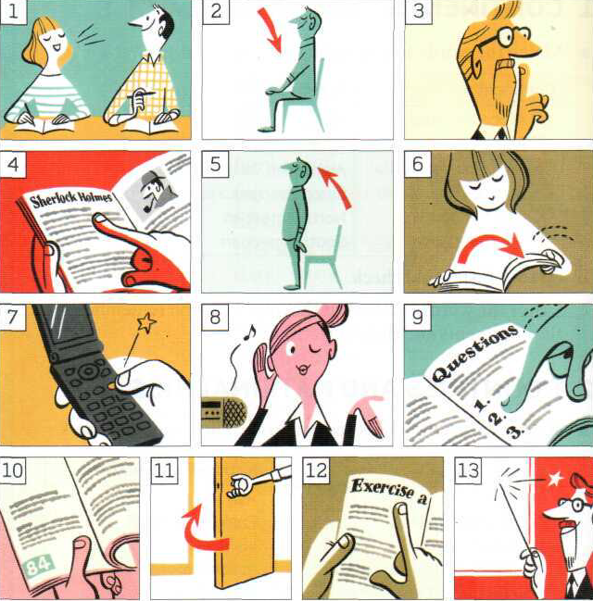
Page
150
6
10
Number, repeat, memorize and say in a loud voice (many times!)
12
4
13
11
9
8
5
2
7
3

Slide 5
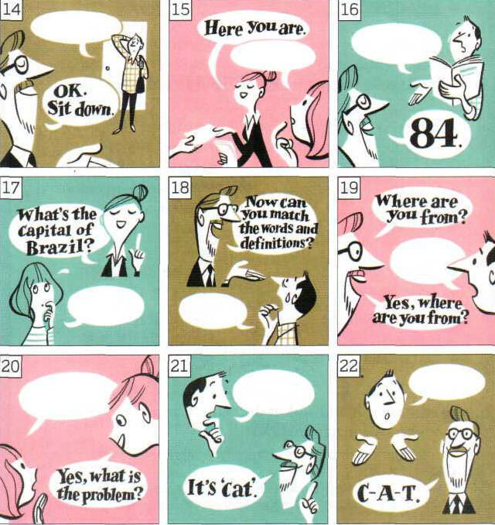
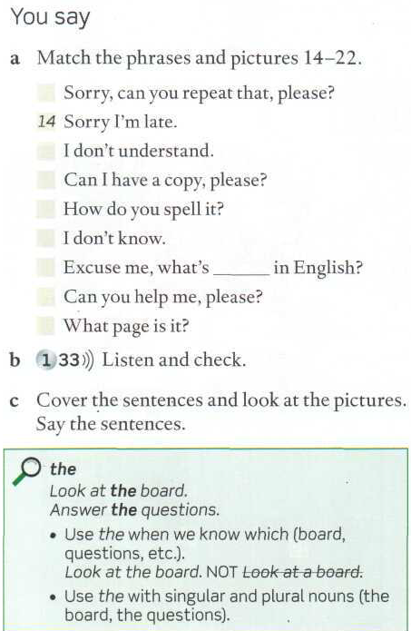
16
18
15
22
17
21
20
16

Slide 6
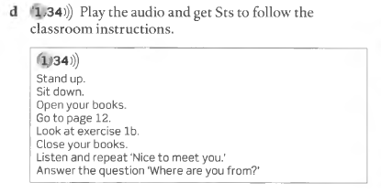
Play the audio and follow the instructions!

Slide 7
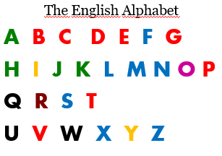
Listen and sing along.
Pay attention to pronunciation and colours

Slide 8

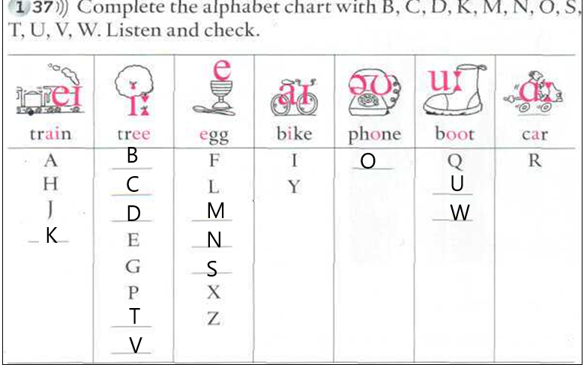
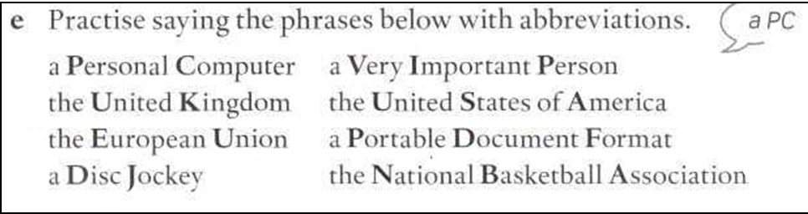
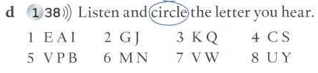

Slide 9
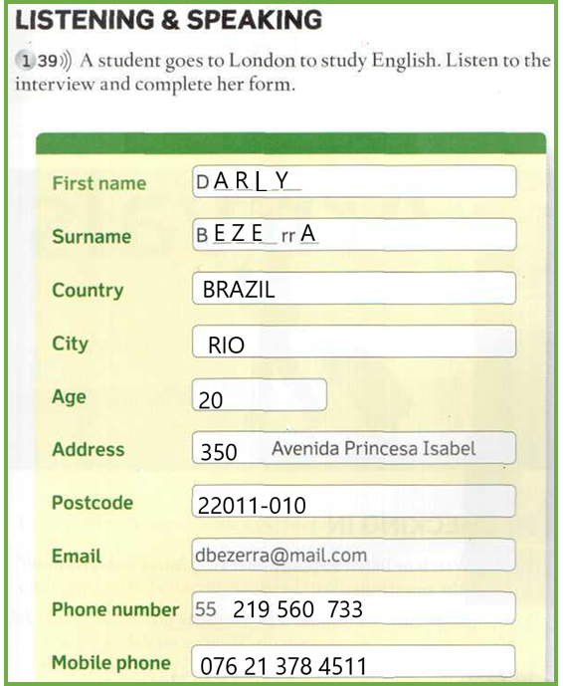


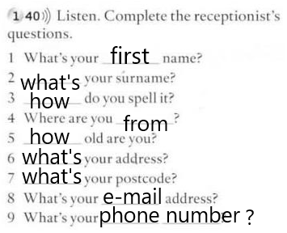

Slide 10
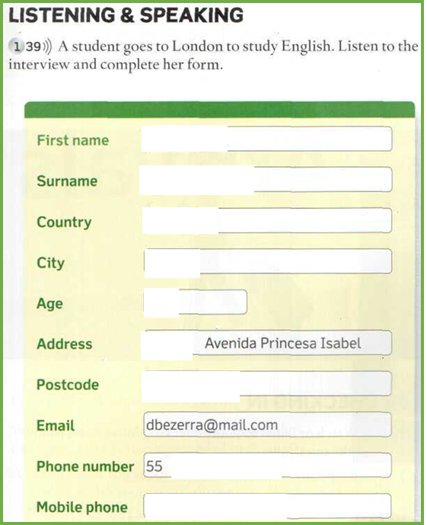


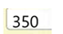

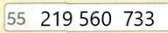
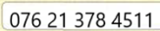

Slide 11
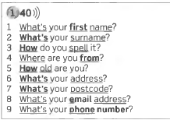
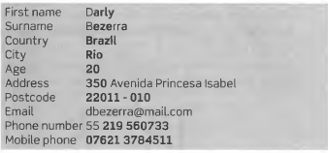
MEMORIZE THESE QUESTIONS FOR AN ORAL EXCHANGE

Slide 12
Practice the dialogues using the clues
first .from
surname .how
spell .what
old .middle
address .email address
postcode .phone number

Slide 13
Personal pronouns | Possessive adjectives
I am | My book
You are | Your book
He is | His book
She is | Her book
It is | Its book
We are | Our book
You are | Your book
They are | Their book

Slide 14
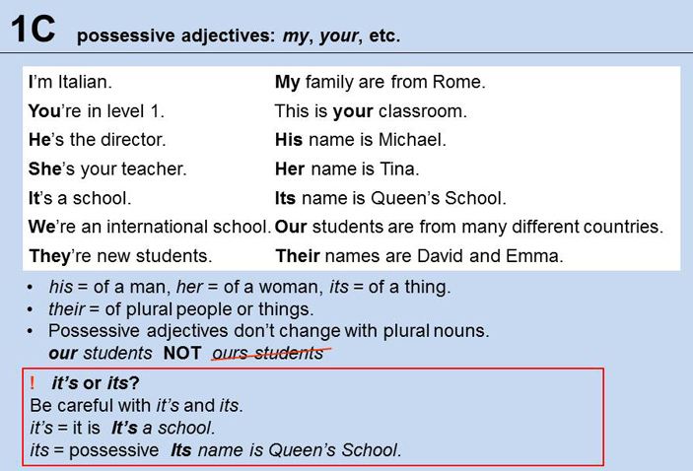






Study possessive adjectives
Listen to the sentences and repeat them several times.
Memorize two of them (the most difficult ones!)
Listen, change the sentences and write them down:
I’m Richard. My name´s Richard.
1.41

Slide 15
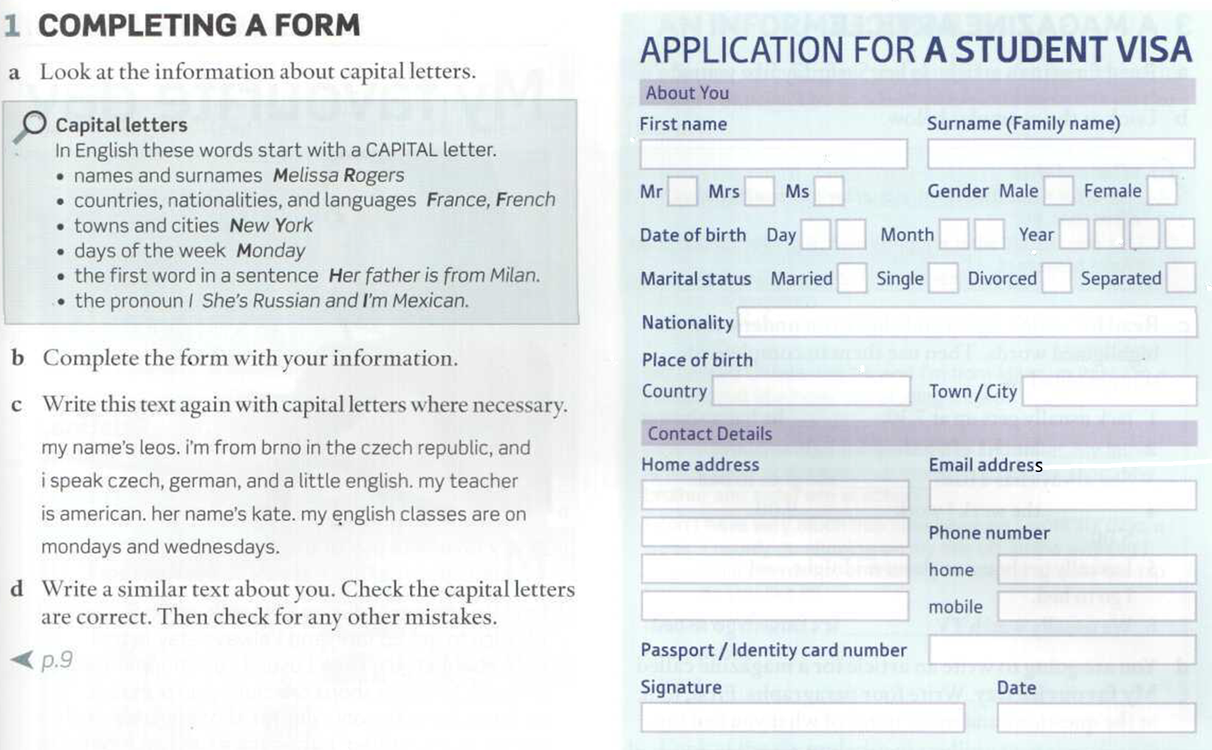

Slide 16
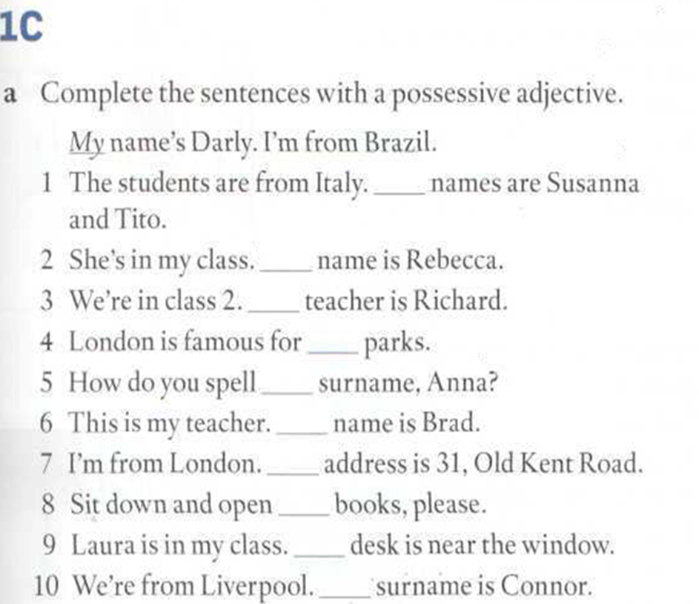
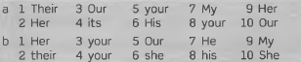
Their
Her
Our
its
your
His
My
your
Her
Our

Slide 17
